Slide 1
Automation Anywhere RPA Hackathon Geek Goddess 2019 [2nd Round]

Slide 2
Brief explanation of idea what makes it unique
We automated the university results as per requirement of Education auditing bodies (i.e. NBA, AICTE, DTE) of India.
We are able to find out the rank of students as per grade achieved and analysis of a results.
Candidates / Students based results generated in a form of approved template (i.e. mark sheet)
No human interaction so error free system developed.

Slide 3
Problem being solved
University declared a result in form of gadget, this file consist of number of pages and very difficult to find specific students record.
In university result, most of student has same name, we can distinguished students as per PRN number and institute code.
By using RPA solution, we are able to create tabular record of each students with conditional field.
In addition, we are able to remove redundancy of a data in record as per conditional field.
Lastly, result of students mail to his/her email id and overall result sent to academic departments with visualization in a form of graph and summarization.

Slide 4


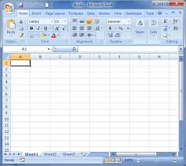
Technical architecture
1st stage
2nd stage
university database
sorted result sent to resp.students throw mail
clg-E
clg-A
PDF-Result
clg-D
clg-B
clg-C
3rd stage-(student result in extracted excelformat)

Slide 5
Technology/Tool Stack
Brief explanation of the technology stack that was used
Automation Anywhere Tool.
Microsoft Excel.
Adobe PDF reader
Gmail API

Slide 6
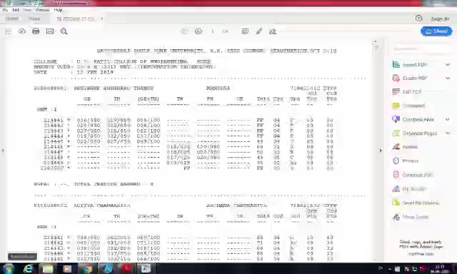
Prototype Demo(Video/Screenshots)

Slide 7
Theme that you are solving
Theme 5 : Be a creative genius
We are using RPA in field of Academic area for handling the administrative work. It helps to teachers and other administrative people to handling result analysis task very effective ways.

Slide 8
Market need to solve the business problem
In most of institute focus on documentation for full filling the requirements of auditing bodies.
All teachers busy in administrative work and result analysis is critical and sensitive types of administrative task.
Result analysis is time consuming task and accuracy required in this work.
Automation in this area helps to teacher in view of increasing accuracy and reducing the time for calculating result of students.

Slide 9
Impact of usage
Increase in Accuracy.
Reduce human interaction and time.
Data is secured and each students get a result via mail.
Go Green concept due to softcopy of data distribution.

Slide 10
Possible Improvement
Near Future, work on password protected result file for secured access.
Add digital signature in file for validation.
Add RPA with Machine Learning or Business Analyst tool (Tableau) for real-time data visualization.

Slide 11
Challenges faced
Any technological challenge that you faced in building the application and how you solved them
1, if university change the gadget file format, then we need to modify the input and code.

Slide 12


